Slide 1

MATH 8650 – Final Project Presentation
OPTIMIZATION OF BELLMAN FORD ALGORITHM
By
Vivek Koodli Udupa
Sai Harsha Nagabothu

Slide 2
Contents
Introduction
Problem Description
Algorithm
Code
Result
Conclusion
Future Work

Slide 3
Introduction
Single Source Shortest Path (SSSP)
SSSP finds the shortest path weights from source to all other nodes in a graph.
Applications
Road networks, logistics, communications, electronic design and power grid contingency analysis.
Algorithms
Floyd-Warshall algorithm, Dijkstra’s, A* and Bellman-Ford are used to find solutions to the shortest path problem upon the search requirements.

Slide 4
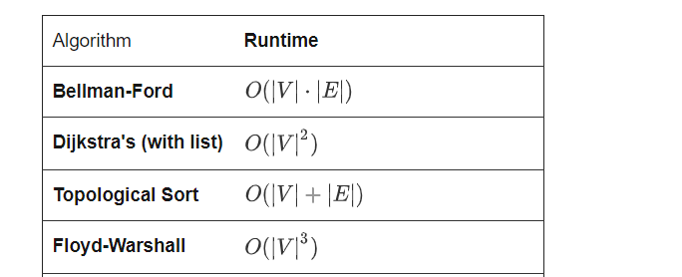
Time Complexity

Slide 5
Bellman Ford Algorithm
The Bellman–Ford algorithm is an algorithm that computes shortest paths from a single source vertex to all of the other vertices in a weighted digraph in which some of the edge weights can be negative.
It can detect negative cycle.

Slide 6
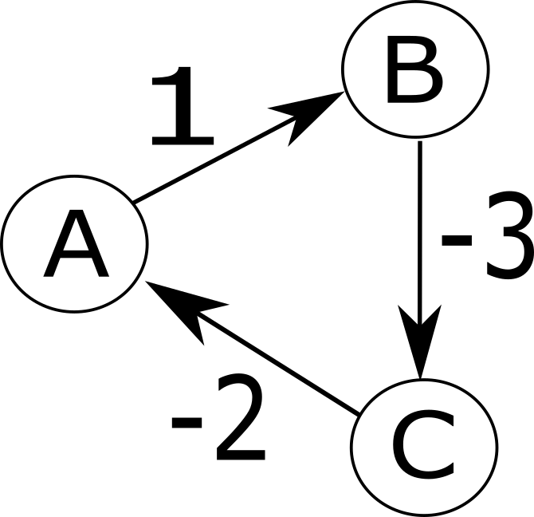
Negative weights and cycles
One might ask how negative weights make sense ?
If talking about distances on a map, they probably do not, but various other problems reduce to shortest paths, and in these reductions negative weights show up.
Negative Cycle
The sum of weights on the cycle is negative. There cannot be a solution in this case. This is because every time we go around the cycle we get a shorter path, so to find a shortest path we would just go around forever.

Slide 7
Bellman Ford Algorithm
The Bellman-Ford algorithm can be described in three steps:
Initialize
The starting node has cost zero and all other nodes have cost infinity
Relax
Algorithm checks every node to see if the sum of cost of that node and the cost of the edge is less than the cost of target node. If so update the target node with least cost.
Detect Negative Cycles
Shorter path found after V-1 iterations signifies the presence of negative cycle.

Slide 8
-1
B
A
B
C
D
E
2
0
∞
∞
∞
∞
-1
0
-1
∞
∞
∞
A
2
E
0
3
1
0
-1
4
∞
∞
1
0
-1
2
∞
∞
4
-3
0
-1
2
∞
1
0
-1
2
1
1
C
5
D
0
-1
2
-2
1
-2
2

Slide 9
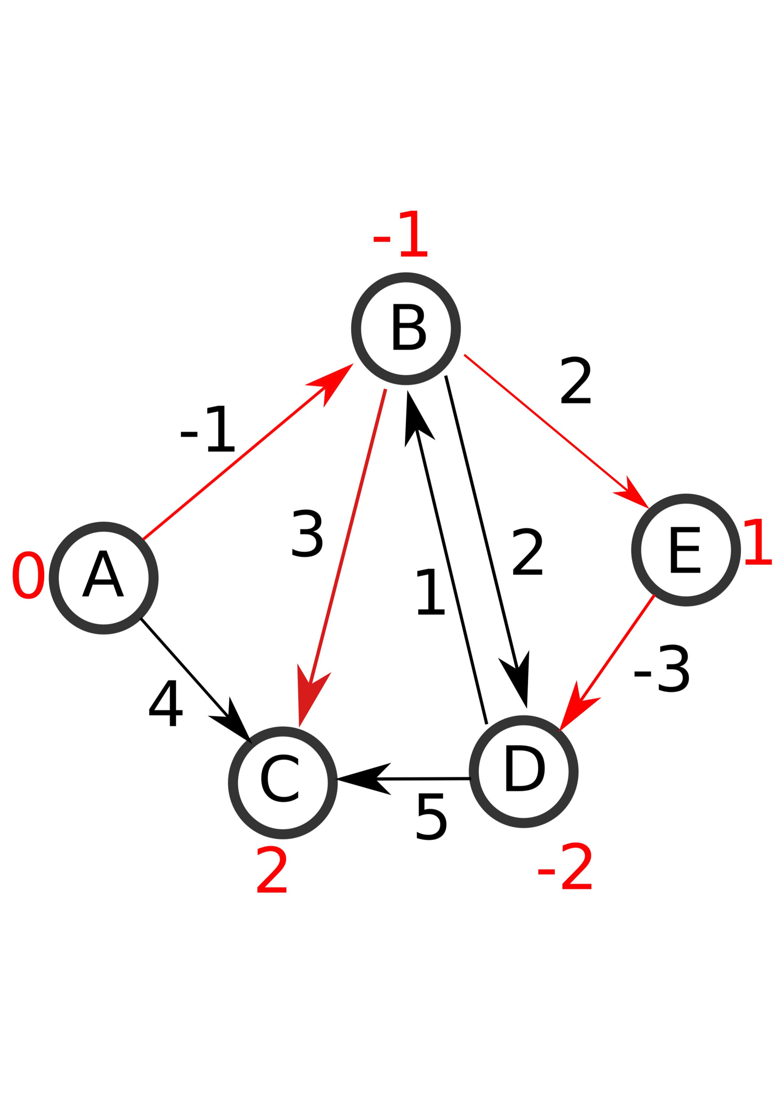
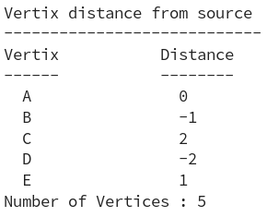

Slide 10
Shortest Path Faster Algorithm (SPFA)
The Shortest Path Faster Algorithm (SPFA) is an improvement of the Bellman–Ford algorithm which computes single-source shortest paths in a weighted directed graph.
The basic idea of SPFA is the same as Bellman–Ford algorithm in that each vertex is used as a candidate to relax its adjacent vertices. The improvement over the latter is that instead of trying all vertices blindly, SPFA maintains a queue of candidate vertices and adds a vertex to the queue only if that vertex is relaxed. This process repeats until no more vertex can be relaxed.

Slide 11
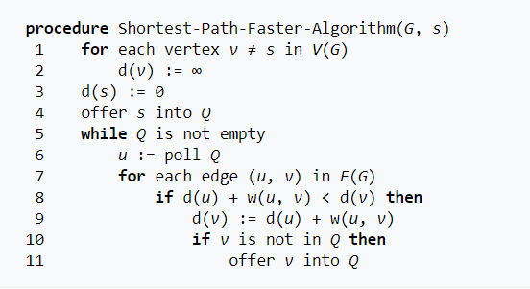
Pseudo Code

Slide 12

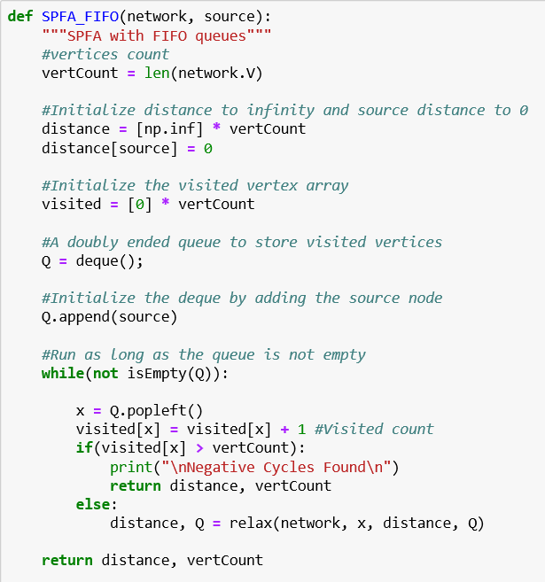
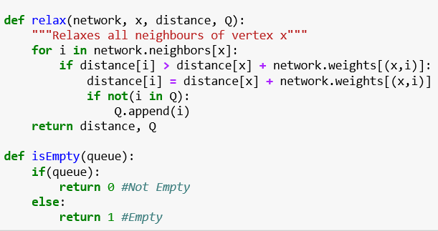
SPFA-FIFO

Slide 13
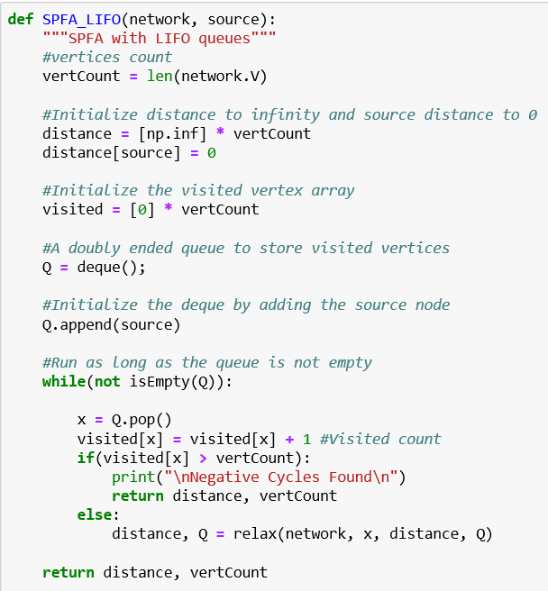
SPFA-LIFO

Slide 14
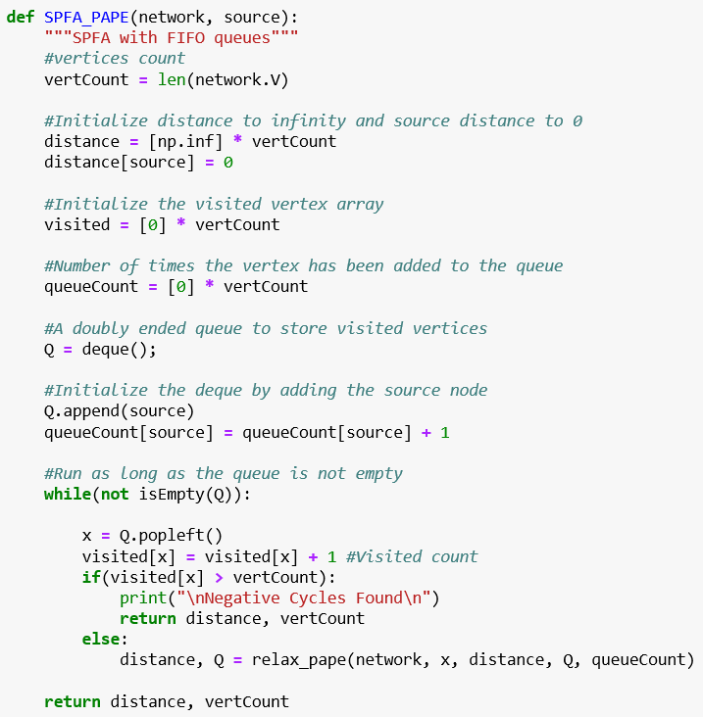
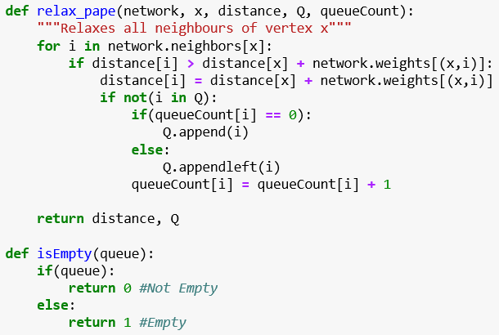
SPFA-PAPE

Slide 15
Results
n – Nodes , ( n * ( n – 1 ) ) / 2 Edges , Weights in range 1 to 10
 | 10 | 20 | 50 | 75 | 100 | 250 | 500 | 750 | 1000 | 1500 | 2000 | 5000
DIJKSTRA | 37.7 usec | 122 usec | 637 usec | 1.03 msec | 1.86 msec | 8.4 msec | 30.2 msec | 69.2 msec | 148 msec | 424 msec | 733 msec | 4.54 sec
Bellman-Ford | 120 usec | 501 usec | 3.2 msec | 7.38 msec | 19.3 msec | 115 msec | 422 msec | 1.03 sec | 1.95 sec | 6.23 sec | 11.2 sec | 75 sec
SPFA FIFO | 14 usec | 46.7usec | 266 usec | 528 usec | 1.11 msec | 7.35 msec | 28.8 msec | 79 msec | 169 msec | 451 msec | 815 msec | 4.87 sec
SPFA LIFO | 14.4 usec | 44.7 usec | 286 usec | 640 usec | 1.21 msec | 7.09 msec | 32.6 msec | 90 msec | 179 msec | 474 msec | 781 msec | 5.23 sec
SPFA PAPE | 15 usec | 51.2 usec | 294 usec | 557 usec | 1.19 msec | 7.72 msec | 33.8 msec | 80.7 msec | 169 msec | 473 msec | 884 msec | 4.94 sec

Slide 16
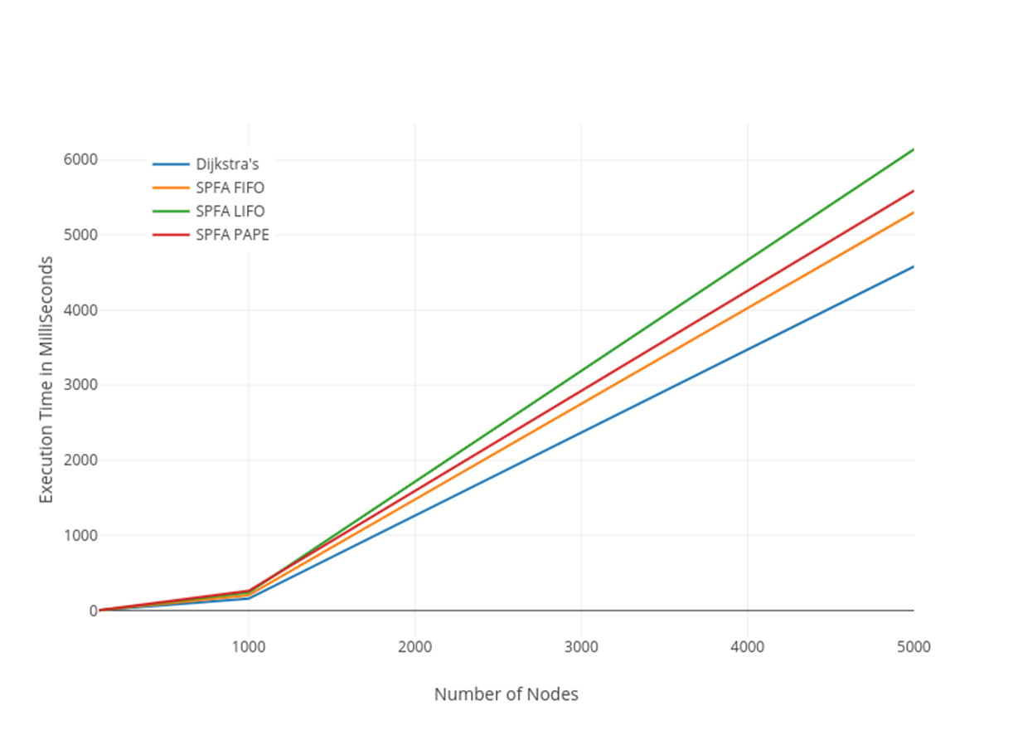
Results (Contd.)
n – Nodes , ( n * ( n – 1 ) ) / 2 Edges , Weights in range 1 to 20
 | 100 | 1000 | 5000
Dijkstra’s | 2.24 msec | 158 msec | 4.58 sec
Bellman-Ford | 17.6 msec | 2.66 sec | 73 sec
SPFA FIFO | 1.24 msec | 202 msec | 5.3 sec
SPFA LIFO | 1.28 msec | 239 msec | 6.14 sec
SPFA PAPE | 1.36 msec | 261 msec | 5.59 sec

Slide 17
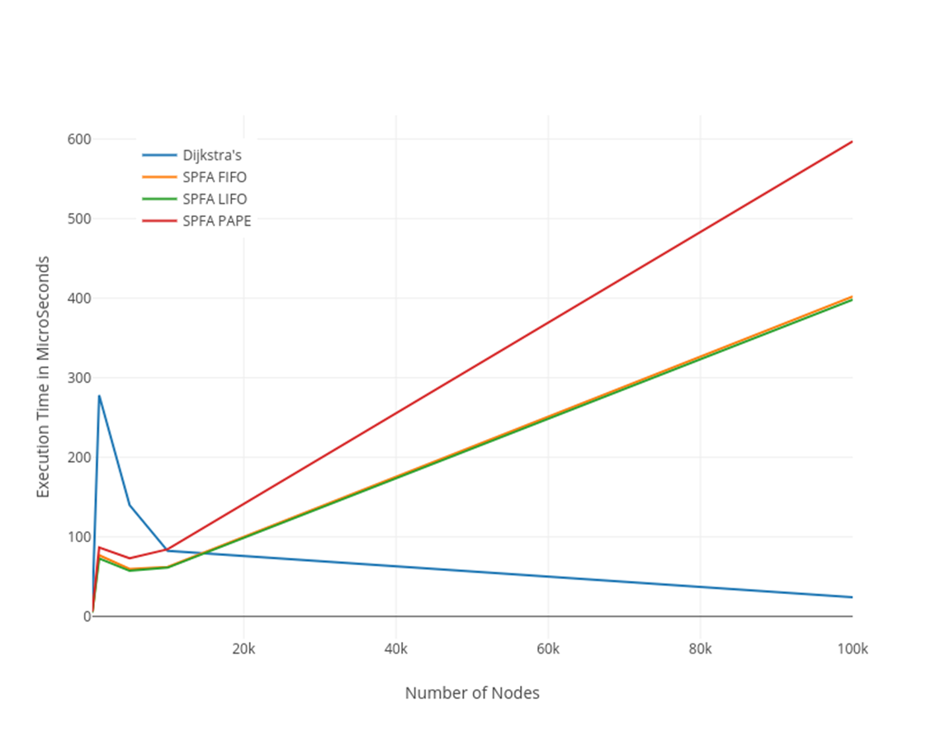
Results (Contd.)
n – Nodes , 2n Edges , Weights in range 1 to 20
 | 100 | 1000 | 5000 | 10000 | 100000
Dijkstra’s | 11.3 usec | 278 usec | 140 usec | 82.4 usec | 24.1 usec
Bellman-Ford | 341 usec | 6.82 msec | 28 msec | 55.6 msec | 478 msec
SPFA FIFO | 5.27 usec | 77 usec | 59.8 usec | 62.2 usec | 402 usec
SPFA LIFO | 4.89 usec | 73 usec | 57.4 usec | 61.3 usec | 398 usec
SPFA PAPE | 6.13 usec | 86.7 usec | 73 usec | 84.4 usec | 597 usec

Slide 18
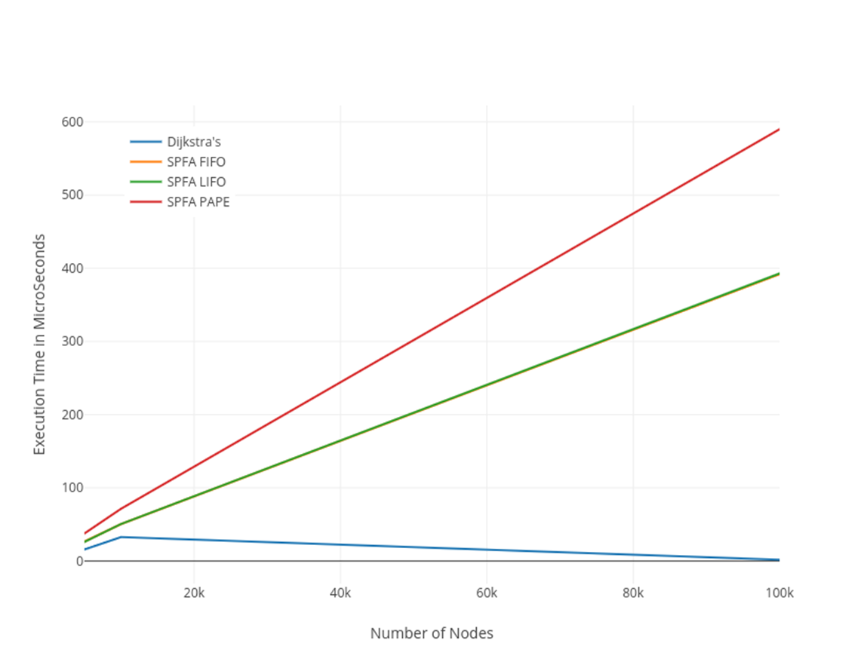
Results (Contd.)
n – Nodes , n - 1 Edges , Weights in range 1 to 20
 | 5000 | 10000 | 100000
Dijkstra’s | 15.8 usec | 32.6 usec | 1.61 usec
Bellman-Ford | 8.28 msec | 28.2 msec | 78.1 msec
SPFA FIFO | 26.5 usec | 50.3 usec | 392 usec
SPFA LIFO | 26.1 usec | 50.4 usec | 393 usec
SPFA PAPE | 37.4 usec | 71.3 usec | 590 usec

Slide 19
Results(Contd.)
n – Nodes , ( n * ( n – 1 ) ) / 2 Edges , Weights in range -10 to 60
 | 10 | 20 | 50 | 75 | 100 | 250 | 500 | 1000
Bellman-Ford | 165 usec | 887 usec | 8.88 msec | 31.2 msec | 82.4 msec | 866 msec | 9.82 sec | 83 sec
SPFA FIFO | 15.4 usec | 64.3 usec | 734 usec | 1.92 msec | 4.68 msec | 73.4 msec | 731 msec | 8.31 sec
SPFA LIFO | 14.8 usec | 82.1 usec | 927 usec | 2.77 msec | 6.73 msec | 140 msec | 1.68 sec | 21.8 sec
SPFA PAPE | 16.4 usec | 71.6 usec | 945 usec | 2.25 msec | 6.12 msec | 142 msec | 1.56 sec | 20.6 sec

Slide 20
Conclusion
Goal : Optimize Bellman-Ford algorithm to get run time closer to Dijkstra’s.
For high edge density graph SPFA performance is notably close to Dijkstra’s.
For medium and low edge density graphs Dijkstra’s holds an upper hand.
For non-negative weights -> prefers Dijkstra’s
For negative weights -> prefers SPFA FIFO

Slide 21
Future Work
Different weight ranges
Higher weight values
Grid Graphs

Slide 22
Questions ?

Slide 23
THANK YOU

